Slide 1
Styles in React
Salman Ahmed G

Slide 2
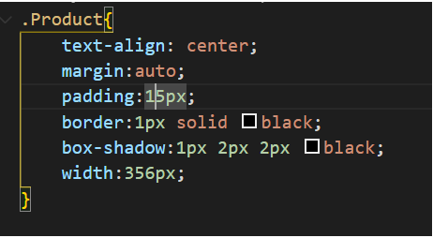
Adding normal class - 1

Slide 3
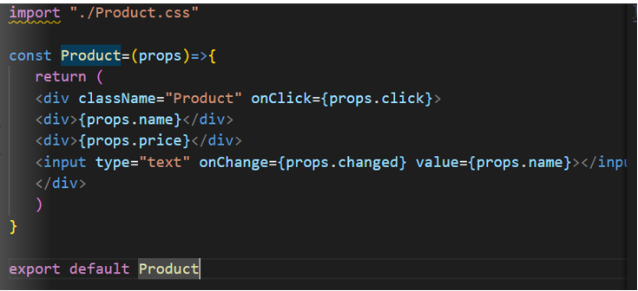
Adding normal class - 2

Slide 4
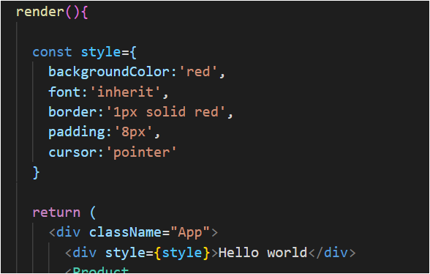
Dynamic inline style

Slide 5
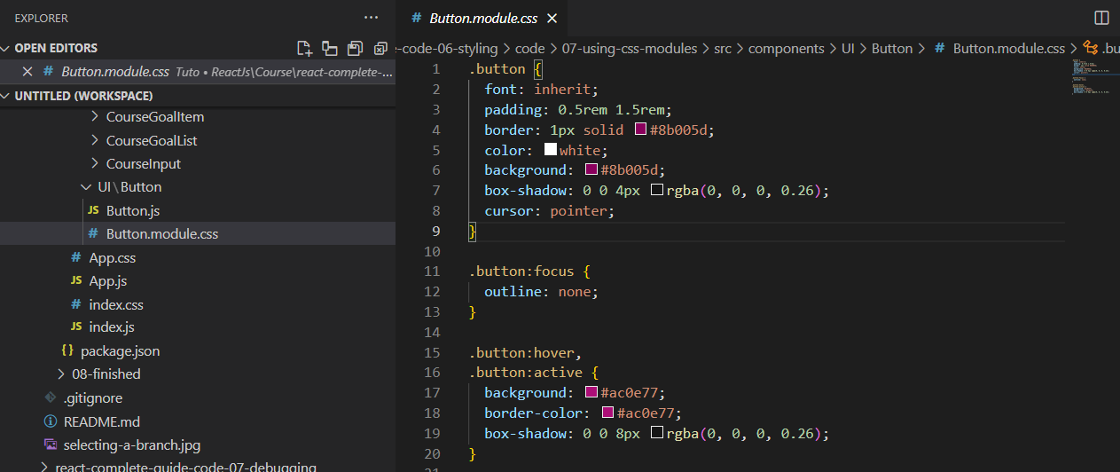
Css modules

Slide 6
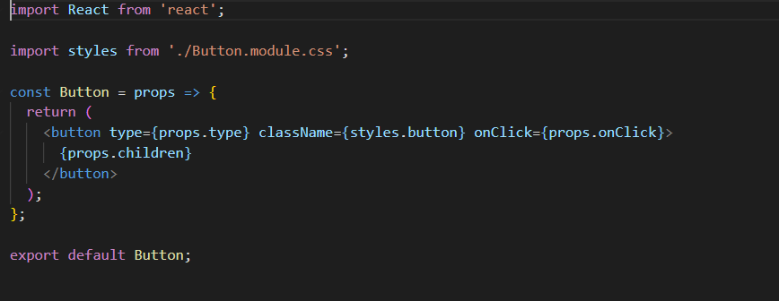
Importing css modules in component

